Slide 1
LV systems structure
VOTS
LANDATA
Planning Certificate System
PSV
Imaging
SPEAR
Geospatial – LASSI / SMES / VICNAMES
LVIS
External
PEXA
SRO
Vicmap

Slide 2
LV systems structure
State Revenue Office
(SRO)
Property Exchange Australia
(PEXA)
SPEAR
Vicmap
PSV
Victorian Online Titles System (VOTS)
LVIS
LANDATA
LASSI / SMES / VICNAMES
Planning Certificate System
Imaging

Slide 3
What’s a folio?
SRO
PEXA
SPEAR
Vicmap
PSV
VOTS
LVIS
LANDATA
Geospatial
Why have a folio?
Folio
Land
Proprietorship
Interests
Title / duplicate / certificate of title / CT / CofT / eCT / pCT
CT holder / controller
Some transactions which need CT
Guaranteed information
PCS
Imaging
Notes:
When looking at pCT note the fact that the caveat isn’t on the CT (doesn’t require CT and wasn’t re-printed after the CT was issued).
- have a look at date/time of CT issuing and caveat dealing
- see if people know what the CT issuing date / time relates to (when the mortgage was registered)

Slide 4
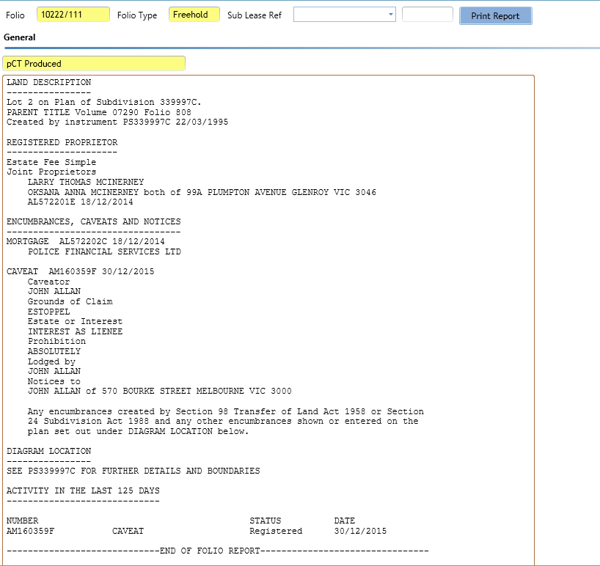
What’s a folio?
LAND DESCRIPTION
----------------
Lot 2 on Plan of Subdivision 339997C.
PARENT TITLE Volume 07290 Folio 808
Created by instrument PS339997C 22/03/1995
REGISTERED PROPRIETOR
---------------------
Estate Fee Simple
Joint Proprietors
LARRY THOMAS MCINERNEY
OKSANA ANNA MCINERNEY both of 99A PLUMPTON AVENUE GLENROY VIC 3046
AL572201E 18/12/2014
ENCUMBRANCES, CAVEATS AND NOTICES
---------------------------------
MORTGAGE AL572202C 18/12/2014
POLICE FINANCIAL SERVICES LTD
CAVEAT AM160359F 30/12/2015
Caveator
JOHN ALLAN
Grounds of Claim
ESTOPPEL
Estate or Interest
INTEREST AS LIENEE
Prohibition
ABSOLUTELY
Lodged by
JOHN ALLAN
Notices to
JOHN ALLAN of 570 BOURKE STREET MELBOURNE VIC 3000
Any encumbrances created by Section 98 Transfer of Land Act 1958 or Section
24 Subdivision Act 1988 and any other encumbrances shown or entered on the
plan set out under DIAGRAM LOCATION below.
DIAGRAM LOCATION
----------------
SEE PS339997C FOR FURTHER DETAILS AND BOUNDARIES
ACTIVITY IN THE LAST 125 DAYS
-----------------------------

Slide 5
What’s a folio?
CAVEAT AM160359F 30/12/2015
Caveator
JOHN ALLAN
Grounds of Claim
ESTOPPEL
Estate or Interest
INTEREST AS LIENEE
Prohibition
ABSOLUTELY
Lodged by
JOHN ALLAN
Notices to
JOHN ALLAN of 570 BOURKE STREET MELBOURNE VIC 3000
Any encumbrances created by Section 98 Transfer of Land Act 1958 or Section
24 Subdivision Act 1988 and any other encumbrances shown or entered on the
plan set out under DIAGRAM LOCATION below.
DIAGRAM LOCATION
----------------
SEE PS339997C FOR FURTHER DETAILS AND BOUNDARIES
ACTIVITY IN THE LAST 125 DAYS
-----------------------------
NUMBER STATUS DATE
AM160359F CAVEAT Registered 30/12/2015
-----------------------------END OF FOLIO REPORT--------------------------------
Additional information: (not part of the Folio Report)
Street Address: 99A PLUMPTON AVENUE GLENROY VIC 3046
OWNERS CORPORATIONS
-------------------
The land in this folio is affected by
OWNERS CORPORATION PLAN NO. PS339997C
DOCUMENT END

Slide 6
What’s a dealing?
SRO
PEXA
SPEAR
Vicmap
PSV
VOTS
LVIS
LANDATA
Geospatial
Lodgements / cases / instruments
Instruments (legal)
Dealings
Registered dealings / instruments again (business & legal)
Dealing
Technique for changing the register
Transaction history
Dealing life cycle: lodgement vs registration
PCS
Imaging
Notes:
Instrument:
Document (can be electronic) which formally authorises some activity
Dealing:
Any instrument or application that is accepted by Land Victoria for processing a registration
Instruments again:
A registered dealing

Slide 7
DTM The most common case
Standard settlement:
Discharge - of old mortgage
Transfer – to new proprietors
Mortgage – to new bank

Slide 8
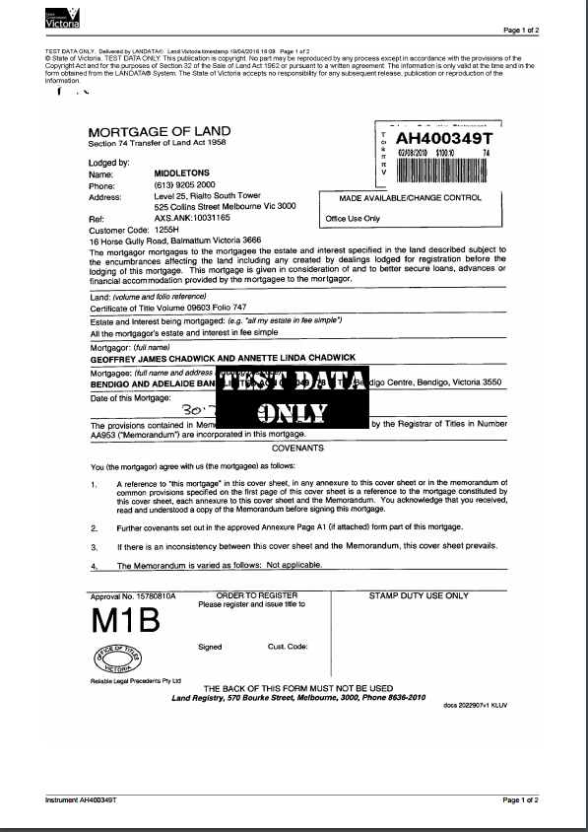
What’s a dealing? Paper instrument

Slide 9
What’s a dealing? Electronic instrument
Responsible Subscriber: BANKMECU
Customer Code: 13091U
Reference:
DISCHARGE OF MORTGAGE
Section 84 Transfer of Land Act 1958
________________________________________________________________________________
The mortgagee or annuitant discharges the land described from the moneys or
annuity secured by the mortgage or charge specified
________________________________________________________________________________
Land: (volume and folio reference) and Mortgagee or Annuitant: (full name)
Volume 10134 Folio 824
Party shown on Register is REGIONAL ONE CREDIT UNION LTD; Party dealing is Mecu
Limited
(Justification is Change of incorporated name - Credit Union)
Volume 10134 Folio 826
Party shown on Register is REGIONAL ONE CREDIT UNION LTD; Party dealing is Mecu
Limited
(Justification is Change of incorporated name - Credit Union)
________________________________________________________________________________
Mortgage or Charge Number:
AE098391Y
________________________________________________________________________________
Subscriber Certifications:
1. The subscriber certifies that, where the subscriber is representing another,
the subscriber is a party to an EC System Rules Representation Agreement with
the Mortgagee it represents or by the Mortgagee's attorney acting under a power
of attorney.
________________________________________________________________________________
Dated: (system date)
12 January 2012
________________________________________________________________________________
Signed by:
Dianne Brooks
(for Mecu Limited)
on behalf of Mecu Limited

Slide 10
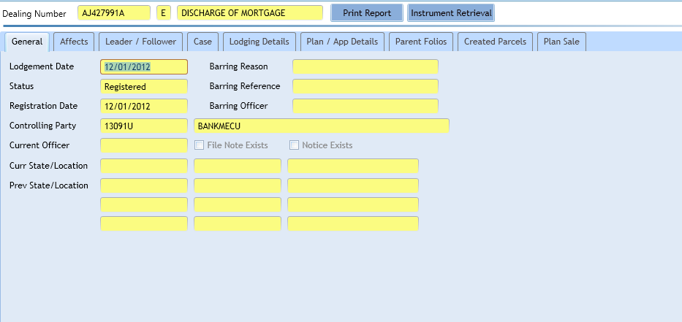
What’s a dealing? Dealing – change the register

Slide 11
What’s a dealing? Dealing – transaction history
HISTORICAL SEARCH STATEMENT Land Victoria
Produced 19/04/2016 04:27 PM
Volume 10134 Folio 824
Folio Creation: Created as paper folio continued as computer folio
RECORD OF ALTS DEALINGS
Date Lodged for Date Recorded Dealing Imaged Dealing Type and
Registration on Register Details
RECORD OF VOTS DEALINGS
Date Lodged for Date Recorded Dealing Imaged
Registration on Register
06/01/2006 06/01/2006 AE098391Y Y
MORTGAGE OF LAND
MORTGAGE AE098391Y 06/01/2006
REGIONAL ONE CREDIT UNION LTD
21/11/2011 25/11/2011 AJ327832E (E) N
APPLICATION TO CONVERT A PCT TO AN ECT
12/01/2012 12/01/2012 AJ427926M (E) N
APPLICATION TO NOMINATE AN ECT TO AN ELECTRONIC INSTRUMENT
ELF Id: 1201AB1023
Removed by Dealing AJ427991A
12/01/2012 12/01/2012 AJ427991A (E) N
DISCHARGE OF MORTGAGE
AFFECTED ENCUMBRANCE(S) AND REMOVED MORTGAGE(S)
MORTGAGE AE098391Y
STATEMENT END

Slide 12
What’s a dealing? Paper instrument – registered dealing

Slide 13
What’s a dealing? Electronic instrument – registered dealing
Produced: 19/04/2016 04:21:11 PM
Dealing Number: AJ427991A
Status: Registered
Date and Time Lodged: 12/01/2012 02:24:33 PM
Responsible Subscriber: BANKMECU
Customer Code: 13091U
Reference:
DISCHARGE OF MORTGAGE
Section 84 Transfer of Land Act 1958
________________________________________________________________________________
The mortgagee or annuitant discharges the land described from the moneys or
annuity secured by the mortgage or charge specified
________________________________________________________________________________
Land: (volume and folio reference) and Mortgagee or Annuitant: (full name)
Volume 10134 Folio 824
Party shown on Register is REGIONAL ONE CREDIT UNION LTD; Party dealing is Mecu
Limited
(Justification is Change of incorporated name - Credit Union)
Volume 10134 Folio 826
Party shown on Register is REGIONAL ONE CREDIT UNION LTD; Party dealing is Mecu
Limited
(Justification is Change of incorporated name - Credit Union)
________________________________________________________________________________
Mortgage or Charge Number:
AE098391Y
________________________________________________________________________________
Subscriber Certifications:
1. The subscriber certifies that, where the subscriber is representing another,
the subscriber is a party to an EC System Rules Representation Agreement with
the Mortgagee it represents or by the Mortgagee's attorney acting under a power
of attorney.
________________________________________________________________________________
Dated: (system date)
12 January 2012
________________________________________________________________________________
Signed by:

Slide 14
Common dealing types
Land restructure
Subdivision
Consolidation
Proprietorship
Transfer
Transmission application
Survivorship application
Record interest
Mortgage
Caveat
Remove interest
Mortgage
Caveat

Slide 15
What’s a land parcel?
SRO
PEXA
SPEAR
Vicmap
PSV
VOTS
LVIS
LANDATA
Geospatial
Relationship to folio
Parcel types
Parishes and townships
Plans
Standard Parcel Identifier (SPI)
PCS
Imaging

Slide 16
What’s a land parcel? Parcel types
SRO
PEXA
SPEAR
Vicmap
PSV
VOTS
LVIS
LANDATA
Geospatial
Lot on Plan
Crown allotment
PCS
Imaging

Slide 17
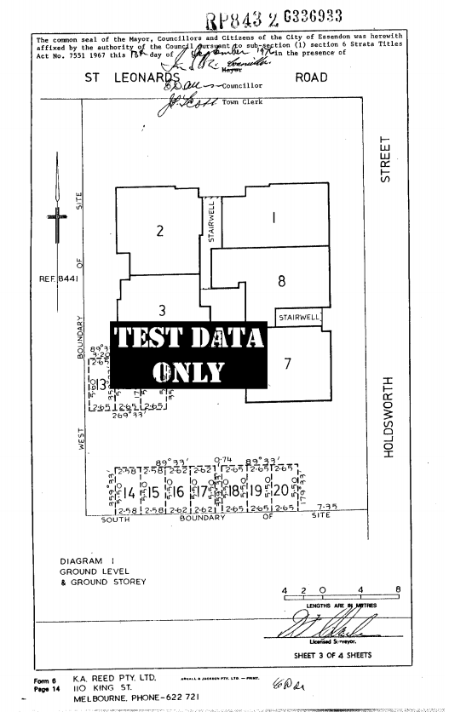
What’s a land parcel? Plan
Lot 1 on RP8432

Slide 18
What’s a land parcel? Parishes and townships

Slide 19
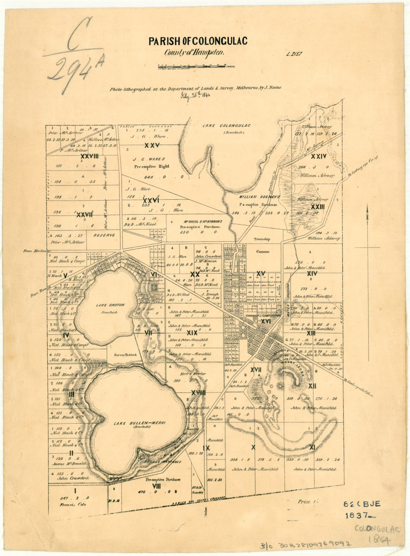
What’s a land parcel? Parishes plan
Crown Allotment 273 Parish of Colongulac

Slide 20
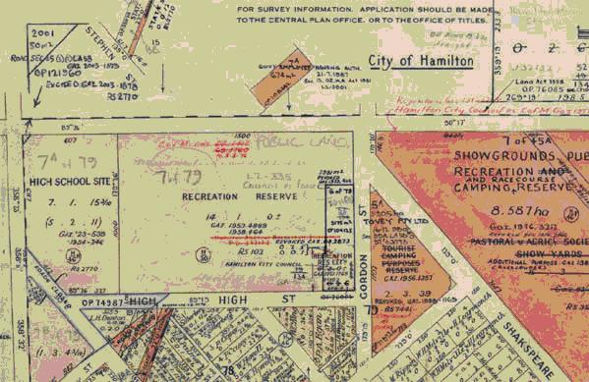
What’s a land parcel? Township plan
Crown Allotment 1 Section 78 Township of Hamilton Parish of Hamilton North

Slide 21
What’s a land parcel? SPI
What is a SPI?
Lot on plan format
{Lot No} \ {Plan No without check digit}
1\RP8432
Parish / township format:
Single value: {Value} \PP {Parish / township code}
1\PP5002
Dual value: {Value1} ~ {value2} \PP {Parish / township code}
1~A\PP5002

Slide 22
What’s a property?
SRO
PEXA
SPEAR
Vicmap
PSV
VOTS
LVIS
LANDATA
Geospatial
Relationships: folio & land parcel
Who decides? Who cares?
Council property number
Common examples
PCS
Imaging

Slide 23
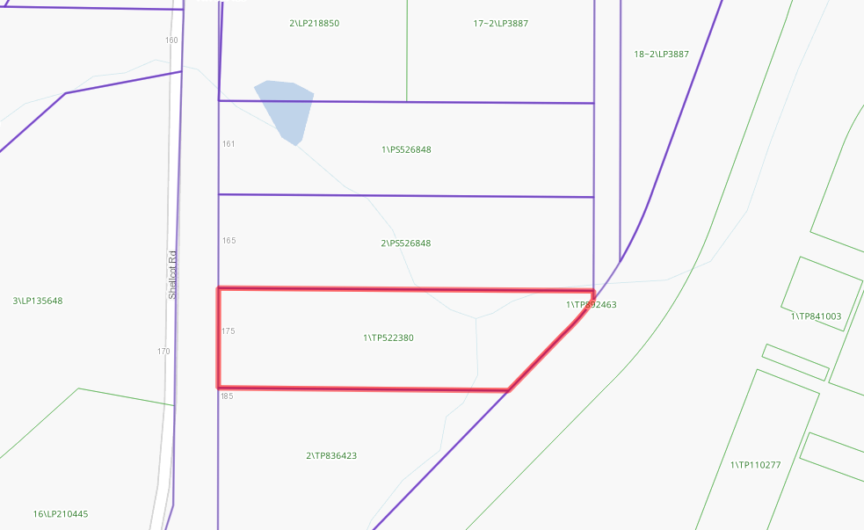
What’s a property? Simple property
10038/004
Notes:
Address: 175 Shellcot Rd
Folio: 10038/004
Parcel: 1\TP522380

Slide 24
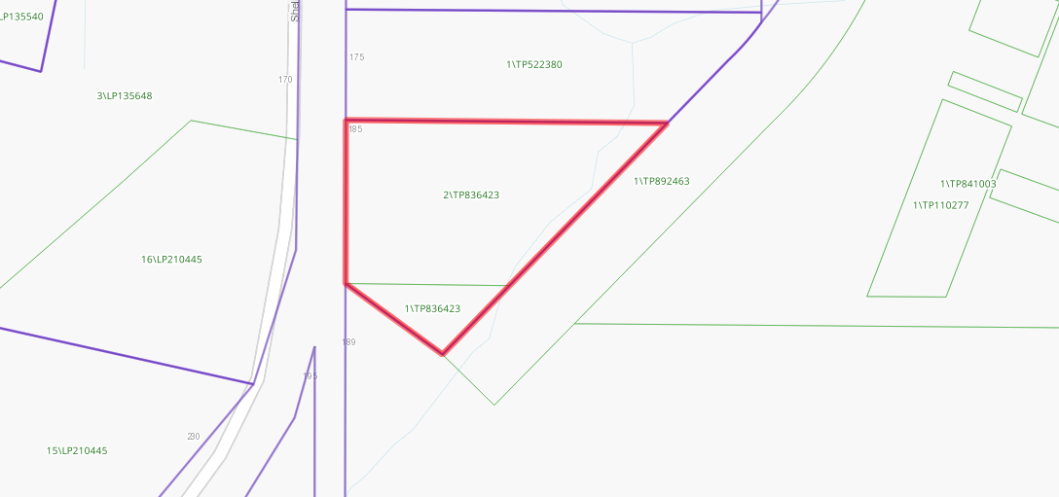
What’s a property? Multi-parcel, single folio property
10020/829
Notes:
Address: 185 Shellcot Rd
Folio: 10020/829
Parcels: 1\TP836423, 2\TP836423

Slide 25
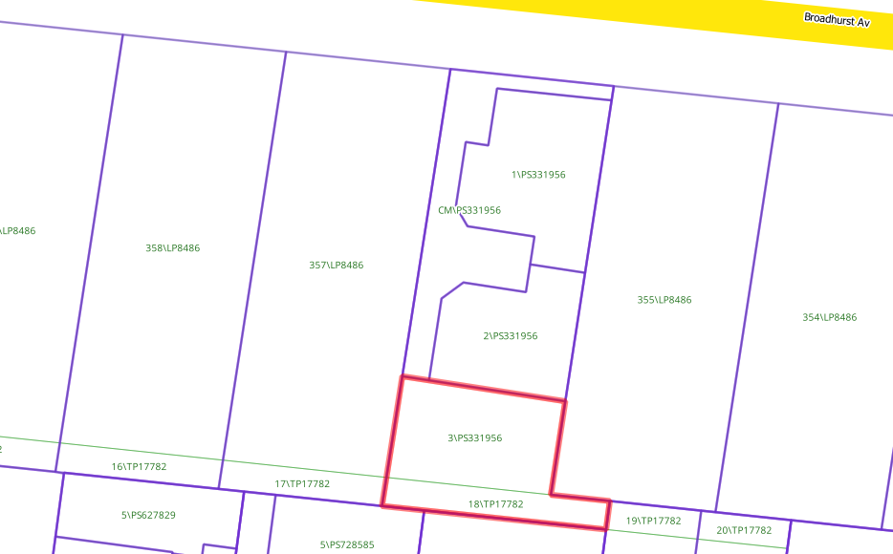
What’s a property? Multi-parcel, multi-folio property
10172/823
10710/366

Slide 26
VOTS services access
LANDATA
PSV
SPEAR
PEXA
SRO

Slide 27
What’s LANDATA?
Land information
Information from VOTS
Information from Imaging
Information from external authorities

Slide 28
LANDATA services access
Broker web services

Slide 29
SPEAR services access
VOTS
External organisations

Slide 30
What’s LVIS?
Look-up Vicmap data
Address services
Parcel services
Spatial services

Slide 31
LVIS services access
LANDATA
PSV
SPEAR
External facing services

Slide 32
What’s PSV?
Sales
Valuations

Slide 33
What’s Imaging?
Instruments
Information about destroyed instruments
Plans
Diagrams
Survey mark sketches
SPEAR xml information
Ongoing process for acquiring new images – scanning and direct upload

Slide 34
What’s Imaging? Acquiring images
VOTS
OCR images
SPEAR
Plans & ePlans
SMES & VICNAMES
Imaging
FujiXerox
Direct uploading
e.g. VicRoads
DocMaint
FujiXerox
Paper scanning

Slide 35
Imaging services access
VOTS
LANDATA
SPEAR
LASSI
VICNAMES
SMES

Slide 36
Geospatial systems
LASSI
SMES
VICNAMES
Embedded maps
LANDATA
SPEAR

Slide 37
VicMap integrations
LASSI / LVIS
PSV - LVIS
VOTS extract

Slide 38
SRO
PEXA
SPEAR
Vicmap
PSV
VOTS
LVIS
LANDATA
Geospatial
PCS
Imaging

Slide 39
LV systems structure
State Revenue Office
(SRO)
Property Exchange Australia
(PEXA)
SPEAR
Vicmap
PSV
Victorian Online Titles System (VOTS)
LVIS
LANDATA
LASSI / SMES / VICNAMES
Planning Certificate System
Imaging

Slide 40
LV systems structure
VOTS
LANDATA
Planning Certificate System
PSV
Imaging
SPEAR
Geospatial – LASSI / SMES / VICNAMES
LVIS
External
PEXA
SRO
Vicmap

Slide 41
LV systems scenarios
SRO
PEXA
SPEAR
Vicmap
PSV
VOTS
LVIS
1. SPEAR electronic lodgement
A significant amount of information was being manually entered into VOTS even though it was present in SPEAR. When a lodgement came from SPEAR, VOTS needed to be pre-populated with all available information.
2. PSV property data update
PSV was receiving updates to its property information from a weekly file created by Vicmap. The file did not contain all the information which PSV wanted. In addition, Vicmap wanted LV to take over generating its own data.
3. Delivery of PDFs in geospatial systems
The PDFs delivered via the geospatial systems were using a complicated system which involved calling SPEAR which then called Imaging to retrieve images. A change was needed to enable the geospatial systems to directly retrieve and assemble images into PDFs.
4. Enhance LANDATA Front of House View My Titles
Two changes were required:
1. When a user listed their electronic titles they got the option to view the location on a map. Roads are usually owned by councils and councils usually hold their titles electronically. However, many road parcels are not in Vicmap. In these cases, view on map returned an error.
2. Where a volume/folio had multiple land descriptions, it only displayed the first one. Multiple land descriptions needed to be returned, where applicable.
LANDATA
Geospatial
PCS
Imaging

Slide 42
What’s a folio?
SRO
PEXA
SPEAR
Vicmap
PSV
VOTS
LVIS
LANDATA
Geospatial
Why have a folio?
Folio
Land
Proprietorship
Interests
Title / duplicate / certificate of title / CT / CofT / eCT / pCT
CT holder / controller
Some transactions which need CT
Guaranteed information
PCS
Imaging

Slide 43
What’s a folio?
LAND DESCRIPTION
----------------
Lot 2 on Plan of Subdivision 339997C.
PARENT TITLE Volume 07290 Folio 808
Created by instrument PS339997C 22/03/1995
REGISTERED PROPRIETOR
---------------------
Estate Fee Simple
Joint Proprietors
LARRY THOMAS MCINERNEY
OKSANA ANNA MCINERNEY both of 99A PLUMPTON AVENUE GLENROY VIC 3046
AL572201E 18/12/2014
ENCUMBRANCES, CAVEATS AND NOTICES
---------------------------------
MORTGAGE AL572202C 18/12/2014
POLICE FINANCIAL SERVICES LTD
CAVEAT AM160359F 30/12/2015
Caveator
JOHN ALLAN
Grounds of Claim
ESTOPPEL
Estate or Interest
INTEREST AS LIENEE
Prohibition
ABSOLUTELY
Lodged by
JOHN ALLAN
Notices to
JOHN ALLAN of 570 BOURKE STREET MELBOURNE VIC 3000
Any encumbrances created by Section 98 Transfer of Land Act 1958 or Section
24 Subdivision Act 1988 and any other encumbrances shown or entered on the
plan set out under DIAGRAM LOCATION below.
DIAGRAM LOCATION
----------------
SEE PS339997C FOR FURTHER DETAILS AND BOUNDARIES
ACTIVITY IN THE LAST 125 DAYS
-----------------------------

Slide 44
What’s a folio?
CAVEAT AM160359F 30/12/2015
Caveator
JOHN ALLAN
Grounds of Claim
ESTOPPEL
Estate or Interest
INTEREST AS LIENEE
Prohibition
ABSOLUTELY
Lodged by
JOHN ALLAN
Notices to
JOHN ALLAN of 570 BOURKE STREET MELBOURNE VIC 3000
Any encumbrances created by Section 98 Transfer of Land Act 1958 or Section
24 Subdivision Act 1988 and any other encumbrances shown or entered on the
plan set out under DIAGRAM LOCATION below.
DIAGRAM LOCATION
----------------
SEE PS339997C FOR FURTHER DETAILS AND BOUNDARIES
ACTIVITY IN THE LAST 125 DAYS
-----------------------------
NUMBER STATUS DATE
AM160359F CAVEAT Registered 30/12/2015
-----------------------------END OF FOLIO REPORT--------------------------------
Additional information: (not part of the Folio Report)
Street Address: 99A PLUMPTON AVENUE GLENROY VIC 3046
OWNERS CORPORATIONS
-------------------
The land in this folio is affected by
OWNERS CORPORATION PLAN NO. PS339997C
DOCUMENT END

Slide 45
What’s different? Who has the CT? 1
**************************** FOLIO IS CANCELLED *******************************
LAND DESCRIPTION
----------------
Lot 1 on Title Plan 198562J (formerly known as Lot 121 on Plan of Subdivision
004054).
PARENT TITLE Volume 09516 Folio 506
Created by instrument P625283M 23/01/1990
REGISTERED PROPRIETOR
---------------------
Estate Fee Simple
Sole Proprietor
HELEN MARGARET COTTEW of "ARDCHOILLE" TURNER AVENUE WOODEND
P625283M 23/01/1990
ENCUMBRANCES, CAVEATS AND NOTICES
---------------------------------
Any encumbrances created by Section 98 Transfer of Land Act 1958 or Section
24 Subdivision Act 1988 and any other encumbrances shown or entered on the
plan set out under DIAGRAM LOCATION below.
AGREEMENT Section 173 Planning and Environment Act 1987
AC328820S 11/09/2003
DIAGRAM LOCATION
----------------
SEE TP198562J FOR FURTHER DETAILS AND BOUNDARIES
ACTIVITY IN THE LAST 125 DAYS
-----------------------------
NIL
THIS FOLIO HAS BEEN CANCELLED
SEE FOLIOS:
10956/159 LIVE Lot 1 on Plan of Subdivision 530949X
10956/160 LIVE Lot 2 on Plan of Subdivision 530949X
10956/161 LIVE Lot 3 on Plan of Subdivision 530949X
10956/162 LIVE Lot 4 on Plan of Subdivision 530949X
-----------------------------END OF FOLIO REPORT--------------------------------
Additional information: (not part of the Folio Report)
Street Address: 80 TURNER AVENUE MOUNT MACEDON VIC 3441
DOCUMENT END

Slide 46
What’s different? Who has the CT? 2
CROWN GRANT
LAND DESCRIPTION
----------------
Crown Allotment 2L Section 7 Township of Donald Parish of Banyenong.
REGISTERED PROPRIETOR
---------------------
Estate Fee Simple
Sole Proprietor
PEAGROWERS CO-OPERATIVE LTD of 45 WOODS ST DONALD 3480
S613683G 03/08/1993
ENCUMBRANCES, CAVEATS AND NOTICES
---------------------------------
MORTGAGE AB902898L 25/02/2003
SUNCORP-METWAY LTD
Any crown grant reservations exceptions conditions limitations and powers
noted on the plan or imaged folio set out under DIAGRAM LOCATION below.
For details of any other encumbrances see the plan or imaged folio set out
under DIAGRAM LOCATION below.
DIAGRAM LOCATION
----------------
SEE TP065382E FOR FURTHER DETAILS AND BOUNDARIES
ACTIVITY IN THE LAST 125 DAYS
-----------------------------
NUMBER STATUS DATE
AL932411N DISCHARGE OF MORTGAGE Unregistered 03/06/2015
AL932413J DISPOSITION OF LAND Unregistered 03/06/2015
AL932414G MORTGAGE Unregistered 03/06/2015
DOCUMENT END

Slide 47
What’s different? Who has the CT? 3
LAND DESCRIPTION
----------------
Lot 9 on Plan of Subdivision 002141.
PARENT TITLE Volume 02261 Folio 045
Created by instrument 1842763 11/12/1941
REGISTERED PROPRIETOR
---------------------
Estate Fee Simple
Sole Proprietor
PATRICIA ELIZABETH HAUSER of 8 SHARP STREET NORTHCOTE
G499520 03/02/1977
ENCUMBRANCES, CAVEATS AND NOTICES
---------------------------------
Any encumbrances created by Section 98 Transfer of Land Act 1958 or Section
24 Subdivision Act 1988 and any other encumbrances shown or entered on the
plan or imaged folio set out under DIAGRAM LOCATION below.
DIAGRAM LOCATION
----------------
SEE LP002141 FOR FURTHER DETAILS AND BOUNDARIES
ACTIVITY IN THE LAST 125 DAYS
-----------------------------
NIL
-----------------------------END OF FOLIO REPORT--------------------------------
Additional information: (not part of the Folio Report)
Street Address: 8 SHARP STREET NORTHCOTE VIC 3070
DOCUMENT END

Slide 48
What’s different? Who has the CT? 4
LAND DESCRIPTION
----------------
Unit 3 on Strata Plan 037198Q and an undivided share in the common property for
the time being described on the plan.
REGISTRATION OF DEALINGS WITH THIS UNIT IS RESTRICTED
PARENT TITLE Volume 08466 Folio 041
Created by instrument SP037198Q 31/01/1991
REGISTERED PROPRIETOR
---------------------
Estate Fee Simple
Sole Proprietor
JANIECE DELANA MIRARCHI of 570 BOURKE STREET MELBOURNE VIC 3000
AM097104R 30/09/2015
ENCUMBRANCES, CAVEATS AND NOTICES
---------------------------------
CAVEAT AM097105P 30/09/2015
Caveator
GROOVY PTY LTD ACN: 010089175
Grounds of Claim
AGREEMENT WITH THE FOLLOWING PARTIES AND DATE.
Parties
THE REGISTERED PROPRIETOR(S), GROOVY PTY LTD ACN: 010089175, GROOVY PTY LTD
ACN: 010089175
Date
30/08/2015
Estate or Interest
FREEHOLD ESTATE
Prohibition
ABSOLUTELY
Lodged by
GENERATOR INVESTMENTS AUSTRALIA LTD
Notices to
GROOVEY BANK of 570 BOURKE STREET MELBOURNE VIC 3000
Any encumbrances created by Section 98 Transfer of Land Act 1958 or
Section 12 Strata Titles Act 1967 and any other encumbrances shown or
entered on the plan set out under DIAGRAM LOCATION below.
DIAGRAM LOCATION
----------------
SEE SP037198Q FOR FURTHER DETAILS AND BOUNDARIES
ACTIVITY IN THE LAST 125 DAYS
-----------------------------
NIL
-----------------------------END OF FOLIO REPORT--------------------------------
Additional information: (not part of the Folio Report)
Street Address: UNIT 3 37 GURNER STREET ST KILDA VIC 3182
ADMINISTRATIVE NOTICES
----------------------
NIL
eCT Control GENERATOR INVESTMENTS AUSTRALIA LTD
Effective from 30/09/2015
OWNERS CORPORATIONS
-------------------
The land in this folio is affected by
OWNERS CORPORATION PLAN NO. SP037198Q
DOCUMENT END

Slide 49
What’s a dealing?
SRO
PEXA
SPEAR
Vicmap
PSV
VOTS
LVIS
LANDATA
Geospatial
Lodgements / cases / instruments
Instruments (legal)
Dealings
Registered dealings / instruments again (business & legal)
Dealing
Technique for changing the register
Transaction history
Dealing life cycle: lodgement vs registration
PCS
Imaging
Notes:
Instrument:
Document (can be electronic) which formally authorises some activity
Dealing:
Any instrument or application that is accepted by Land Victoria for processing a registration
Instruments again:
A registered dealing

Slide 50
DTM The most common case
Standard settlement:
Discharge - of old mortgage
Transfer – to new proprietors
Mortgage – to new bank

Slide 51
What’s a dealing? Paper instrument
Notes:
Instrument:
Document (can be electronic) which formally authorises some activity
Dealing:
Any instrument or application that is accepted by Land Victoria for processing a registration
Instruments again:
A registered dealing

Slide 52
What’s a dealing? Electronic instrument
Responsible Subscriber: BANKMECU
Customer Code: 13091U
Reference:
DISCHARGE OF MORTGAGE
Section 84 Transfer of Land Act 1958
________________________________________________________________________________
The mortgagee or annuitant discharges the land described from the moneys or
annuity secured by the mortgage or charge specified
________________________________________________________________________________
Land: (volume and folio reference) and Mortgagee or Annuitant: (full name)
Volume 10134 Folio 824
Party shown on Register is REGIONAL ONE CREDIT UNION LTD; Party dealing is Mecu
Limited
(Justification is Change of incorporated name - Credit Union)
Volume 10134 Folio 826
Party shown on Register is REGIONAL ONE CREDIT UNION LTD; Party dealing is Mecu
Limited
(Justification is Change of incorporated name - Credit Union)
________________________________________________________________________________
Mortgage or Charge Number:
AE098391Y
________________________________________________________________________________
Subscriber Certifications:
1. The subscriber certifies that, where the subscriber is representing another,
the subscriber is a party to an EC System Rules Representation Agreement with
the Mortgagee it represents or by the Mortgagee's attorney acting under a power
of attorney.
________________________________________________________________________________
Dated: (system date)
12 January 2012
________________________________________________________________________________
Signed by:
Dianne Brooks
(for Mecu Limited)
on behalf of Mecu Limited
Notes:
Instrument:
Document (can be electronic) which formally authorises some activity
Dealing:
Any instrument or application that is accepted by Land Victoria for processing a registration
Instruments again:
A registered dealing

Slide 53
What’s a dealing? Dealing – transaction history
HISTORICAL SEARCH STATEMENT Land Victoria
Produced 19/04/2016 04:27 PM
Volume 10134 Folio 824
Folio Creation: Created as paper folio continued as computer folio
RECORD OF ALTS DEALINGS
Date Lodged for Date Recorded Dealing Imaged Dealing Type and
Registration on Register Details
RECORD OF VOTS DEALINGS
Date Lodged for Date Recorded Dealing Imaged
Registration on Register
06/01/2006 06/01/2006 AE098391Y Y
MORTGAGE OF LAND
MORTGAGE AE098391Y 06/01/2006
REGIONAL ONE CREDIT UNION LTD
21/11/2011 25/11/2011 AJ327832E (E) N
APPLICATION TO CONVERT A PCT TO AN ECT
12/01/2012 12/01/2012 AJ427926M (E) N
APPLICATION TO NOMINATE AN ECT TO AN ELECTRONIC INSTRUMENT
ELF Id: 1201AB1023
Removed by Dealing AJ427991A
12/01/2012 12/01/2012 AJ427991A (E) N
DISCHARGE OF MORTGAGE
AFFECTED ENCUMBRANCE(S) AND REMOVED MORTGAGE(S)
MORTGAGE AE098391Y
STATEMENT END
Notes:
Instrument:
Document (can be electronic) which formally authorises some activity
Dealing:
Any instrument or application that is accepted by Land Victoria for processing a registration
Instruments again:
A registered dealing

Slide 54
What’s a dealing? Paper instrument – registered dealing
Notes:
Instrument:
Document (can be electronic) which formally authorises some activity
Dealing:
Any instrument or application that is accepted by Land Victoria for processing a registration
Instruments again:
A registered dealing

Slide 55
What’s a dealing? Electronic instrument – registered dealing
Produced: 19/04/2016 04:21:11 PM
Dealing Number: AJ427991A
Status: Registered
Date and Time Lodged: 12/01/2012 02:24:33 PM
Responsible Subscriber: BANKMECU
Customer Code: 13091U
Reference:
DISCHARGE OF MORTGAGE
Section 84 Transfer of Land Act 1958
________________________________________________________________________________
The mortgagee or annuitant discharges the land described from the moneys or
annuity secured by the mortgage or charge specified
________________________________________________________________________________
Land: (volume and folio reference) and Mortgagee or Annuitant: (full name)
Volume 10134 Folio 824
Party shown on Register is REGIONAL ONE CREDIT UNION LTD; Party dealing is Mecu
Limited
(Justification is Change of incorporated name - Credit Union)
Volume 10134 Folio 826
Party shown on Register is REGIONAL ONE CREDIT UNION LTD; Party dealing is Mecu
Limited
(Justification is Change of incorporated name - Credit Union)
________________________________________________________________________________
Mortgage or Charge Number:
AE098391Y
________________________________________________________________________________
Subscriber Certifications:
1. The subscriber certifies that, where the subscriber is representing another,
the subscriber is a party to an EC System Rules Representation Agreement with
the Mortgagee it represents or by the Mortgagee's attorney acting under a power
of attorney.
________________________________________________________________________________
Dated: (system date)
12 January 2012
________________________________________________________________________________
Signed by:
Notes:
Instrument:
Document (can be electronic) which formally authorises some activity
Dealing:
Any instrument or application that is accepted by Land Victoria for processing a registration
Instruments again:
A registered dealing

Slide 56
Common dealing types
Land restructure
Subdivision
Consolidation
Proprietorship
Transfer
Transmission application
Survivorship application
Record interest
Mortgage
Caveat
Remove interest
Mortgage
Caveat

